Slide 1
Programming II
(C Programming Language)
Pre-processors and Macros in C
Lecture 19, Monday April 19, 2021
Dr. Ayman ALJARBOUH

Slide 2
Outline
Pre-processor Directives
Pre-processor Operators
Parameterized Macros
Pre-defined Macros

Slide 3
Pre-processor Directives
The C pre-processor is not part of the compiler, but is a separate step in the compilation process
In simplistic terms, C pre-processors are just text substitution tools
They instruct compiler to do required pre-processing before actual compilation
All pre-processor commands begin with a pound symbol (#)

Slide 4
Pre-processor Directives
Below a table of some C pre-processor directives:
Directive | Description
#define | Substitutes a pre-processor macro
#include | Inserts a particular header from another file
#undef | Undefines a pre-processor macro
#ifdef | Returns true if this macro is defined
#ifndef | Returns true if this macro is not defined
#if | Tests if a compile time condition is true
#else | The alternative for #if
#elif | #else an #if in one statement
#endif | Ends pre-processor conditional
#error | Prints error message on stderr
#pragma | Issues special commands to the compiler, using a standardized method

Slide 5



Pre-processor Directives
The following examples demonstrate the work of various directives:
In the above statement, the directive #define is used in the declaration and initialization of a constant. It tells the CPP to replace instances of the constant MAX_ARRAY_LENGTH with 20

Slide 6
Pre-processor Directives
The following examples demonstrate the work of various directives:
The directive #include in the first line tells the CPP to get the header file stdio.h from System Libraries and add the text to the current source file
The directive #include in the second line tells the CPP to get myheader.h from the local directory and add the content to the current source file

Slide 7
Pre-processor Directives
The following examples demonstrate the work of various directives:
In the above code, the directive #ifndef tells the CPP (C pre-processor) to define MESSAGE only if MESSAGE isn't already defined

Slide 8
Pre-processor Directives
The following examples demonstrate the work of various directives:
In the above code, the directive #ifdef tells the CPP (C pre-processor) to process the statements enclosed if DEBUG is defined

Slide 9
Outline
Pre-processor Directives
Pre-processor Operators
Parameterized Macros
Pre-defined Macros

Slide 10
Pre-defined Macros
ANSI C defines a number of macros
The following table lists the pre-defined macros that can be used in C:
Macro | Description
__DATE__ | The current date as a character literal in “MMM DD YYYY” format.
__TIME__ | The current time as a character literal in “HH:MM:SS” format.
__FILE__ | This contains the current filename as a string literal.
__LINE__ | This contains the current line number as a decimal constant.
__STDC__ | Defined as 1 when the compiler compiles with the ANSI standard.

Slide 11
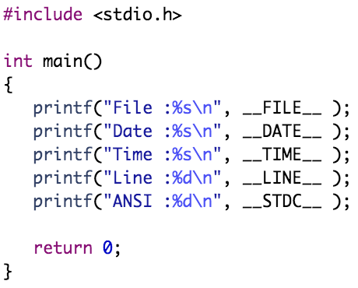
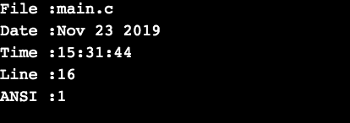
Pre-defined Macros
Example:

Slide 12
Outline
Pre-processor Directives
Pre-processor Operators
Parameterized Macros
Pre-defined Macros

Slide 13

Pre-processor Operators
The C pre-processor offers following operators to help you in creating macros:
Macro Continuation (\):
A macro usually must be contained on a single line
The macro continuation operator is used to continue a macro that is too long for a single line

Slide 14
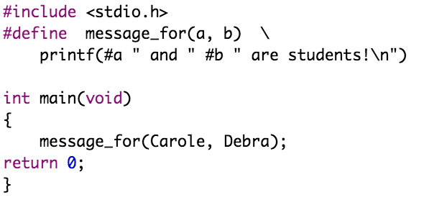
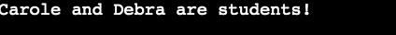
Pre-processor Operators
The C pre-processor offers following operators to help you in creating macros:
Stringize (#):
The stringize or number-sign operator (#) converts a macro parameter into a string constant

Slide 15
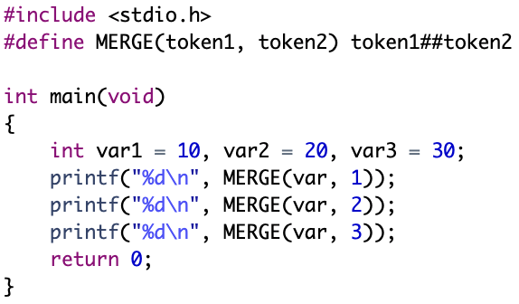
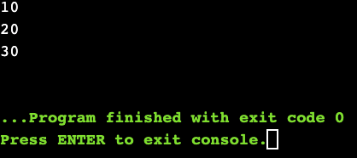
Pre-processor Operators
The C pre-processor offers following operators to help you in creating macros:
Token Pasting (##):
The token-pasting operator (##) permits two separate tokens in the macro definition to be joined into a single token

Slide 16
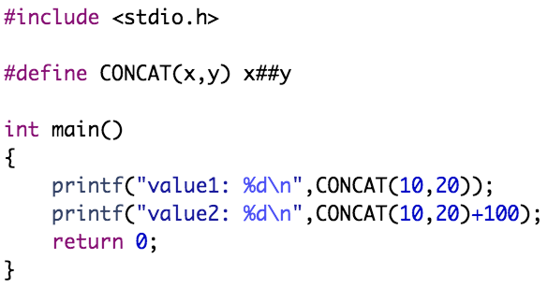
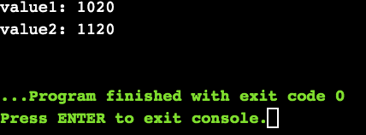
Pre-processor Operators
The C pre-processor offers following operators to help you in creating macros:
Token Pasting (##):
The token-pasting operator (##) permits two separate tokens in the macro definition to be joined into a single token

Slide 17
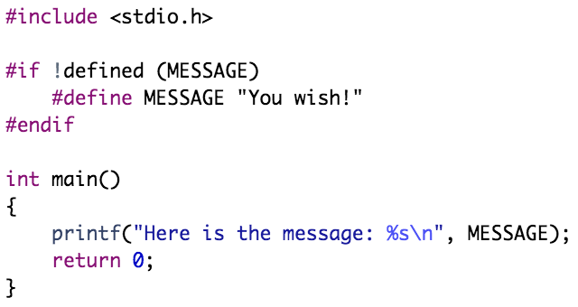
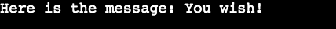
Pre-processor Operators
The C pre-processor offers following operators to help you in creating macros:
defined() Operator:
The defined operator is used to determine if a macro is defined using #define

Slide 18
Outline
Pre-processor Directives
Pre-processor Operators
Parameterized Macros
Pre-defined Macros

Slide 19
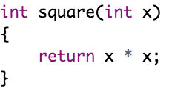
Parameterized Macros
One of the powerful functions of the CPP (C pre-processor) is the ability to simulate functions using parameterized macros
For example, we might have some code to square a number as follows
We can rewrite above code using a macro as follows
Macros with arguments must be defined using the #define directive before they can be used
The argument list is enclosed in parentheses and must immediately follow the macro name
Spaces are not allowed between macro name and open parenthesis

Slide 20
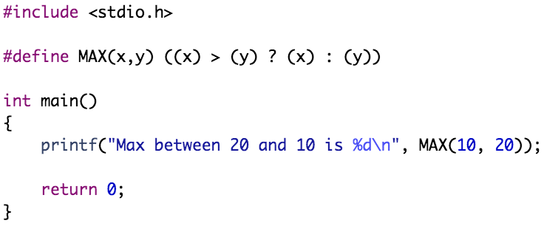
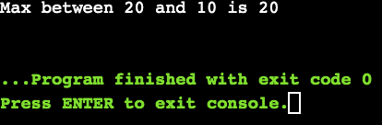
Parameterized Macros
Example:

Slide 21
Practical Exercises
Write and Compile the following C programs:
Program 1:

Slide 22
Practical Exercises
Write and Compile the following C programs:
Program 2:

Slide 23
Practical Exercises
Write and Compile the following C programs:
Program 3:

Slide 24
Practical Exercises
Write and Compile the following C programs:
Program 4:

Slide 25
Practical Exercises
Write and Compile the following C programs:
Program 5:

Slide 26
Practical Exercises
Write and Compile the following C programs:
Program 6:

